Slide 1

Interfacing TM4C123GH6PM microcontroller with NEO-6 GPS Module
EE23DP001: Aditya Shirodkar
EE23MS006: Prasanth Pithanisetty
EECE Department

Slide 2
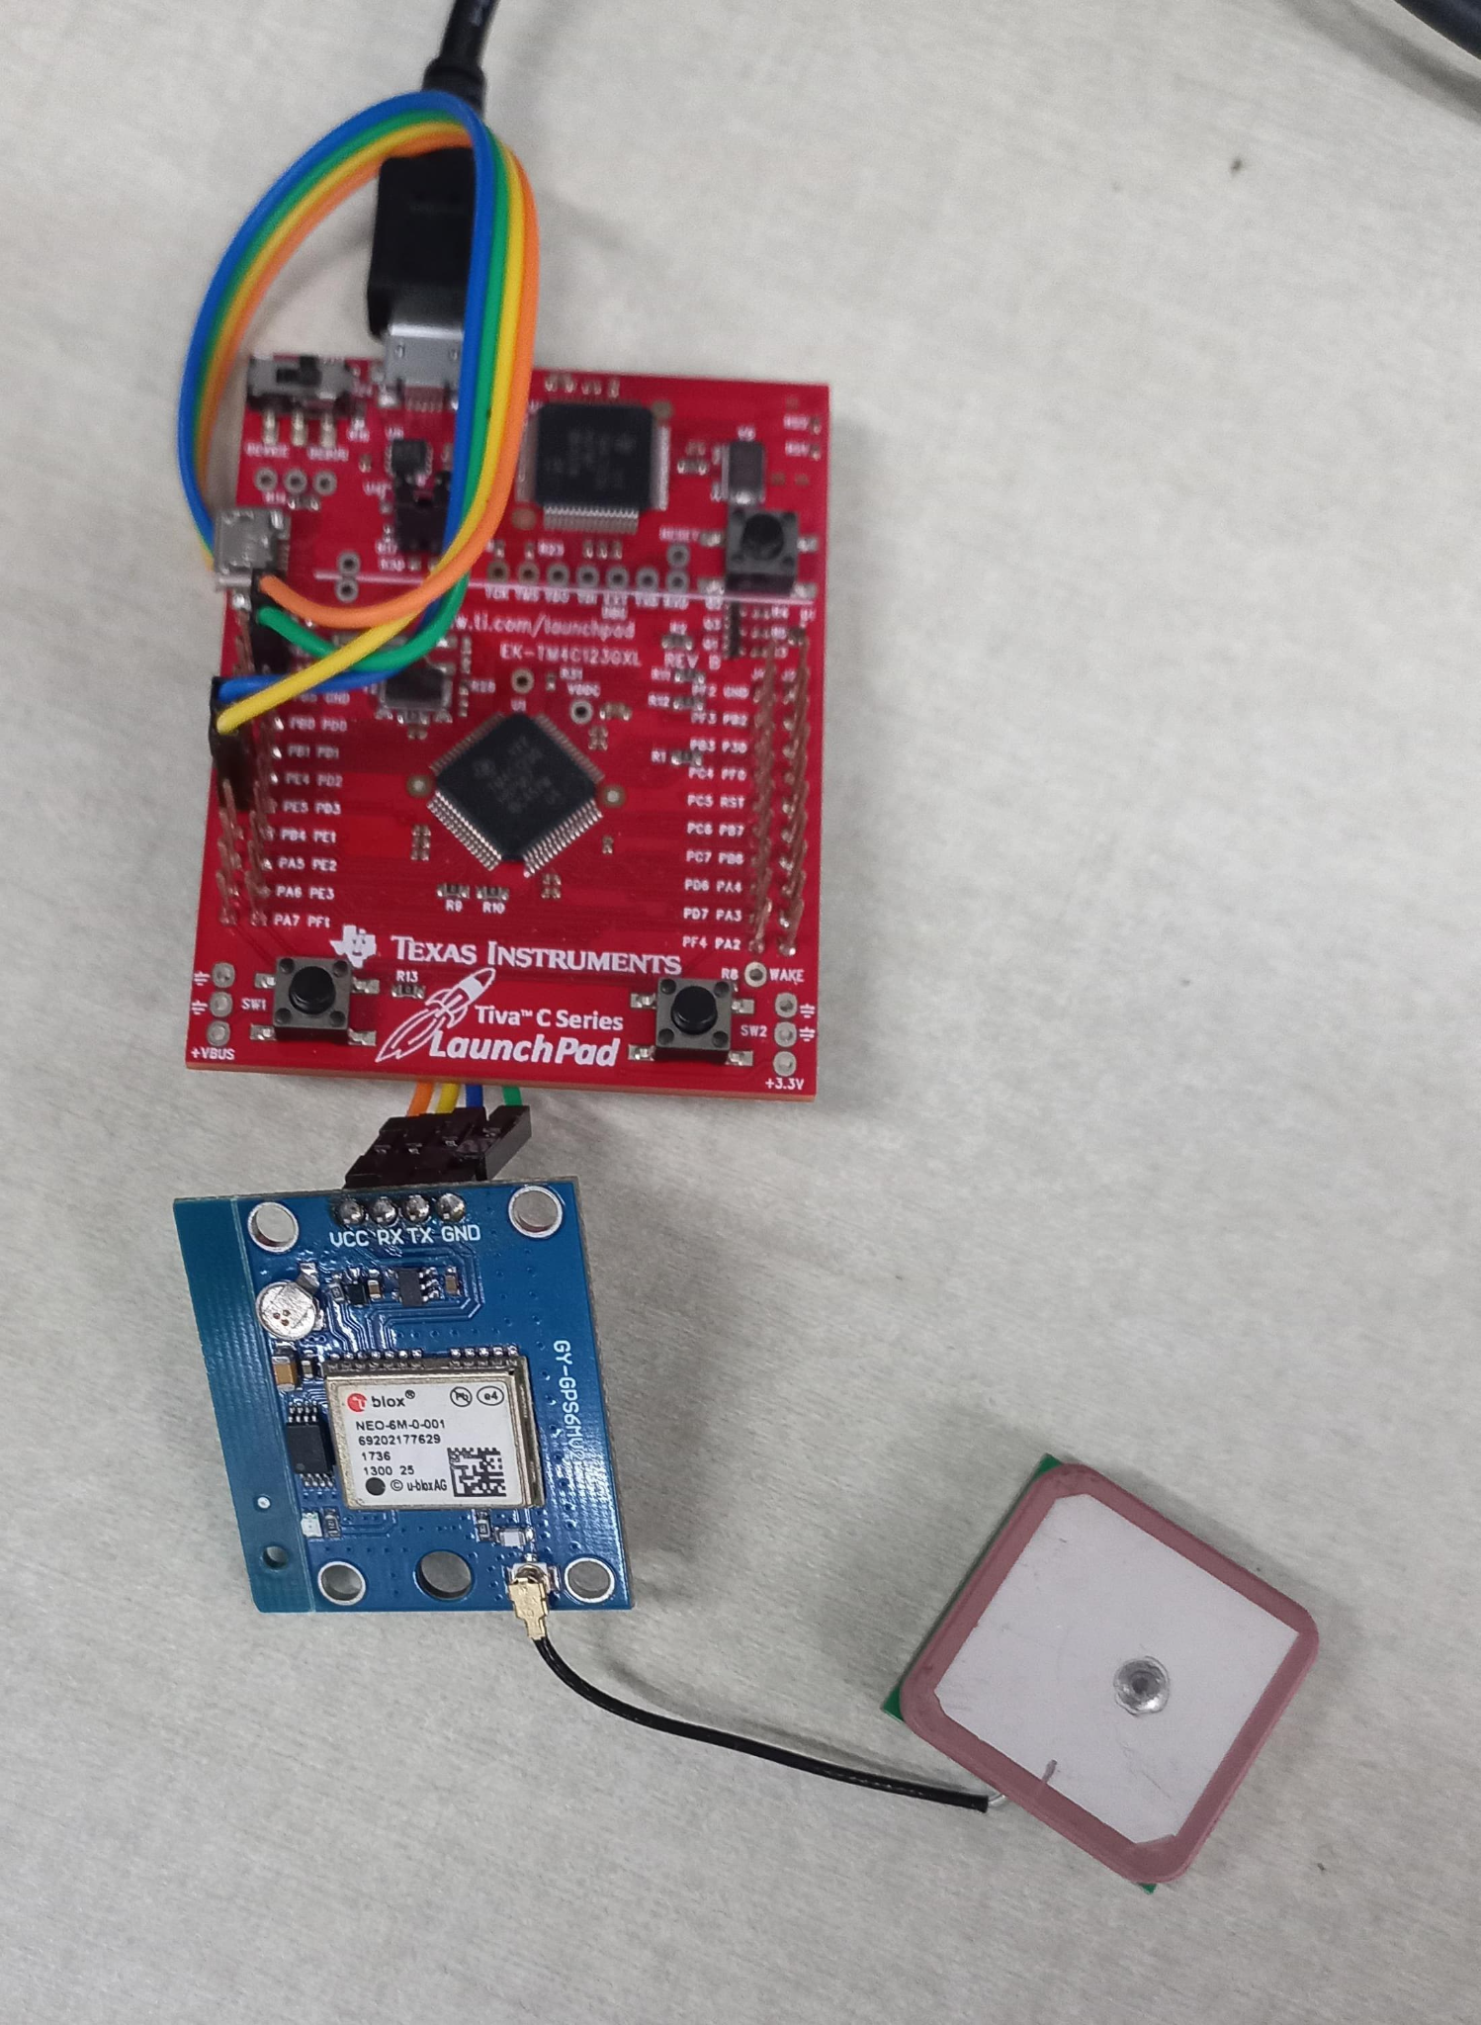
Initialisation
Configure Port E corresponding to UART module 5 for interfacing with GPS module.
From the NEO-6 GPS Module datasheet, it is seen that
By default, the module transmits through UART with 9600 Baud, 8 bits, no parity bit, 1 stop bit
On start-up, the module transmits data in a preset default configuration.
It follows NMEA protocol; sends data in GSV, RMC, GSA, GGA, GLL, VTG and TXT formats.
Hence, UART Module 5 is configured at 9600 Baud, 8 bits, no parity bit, 1 stop bit.
UART Module 0 is configured at 9600 Baud, 8 bits, no parity bit, 1 stop bit.
CodeComposerStudio serial monitor is set to same parameters (9600 Baud, 8 bits, no parity bit, 1 stop bit).
Using PE4, PE5; UART Module 5
PE4 = Rx; PE5 = Tx

Slide 3
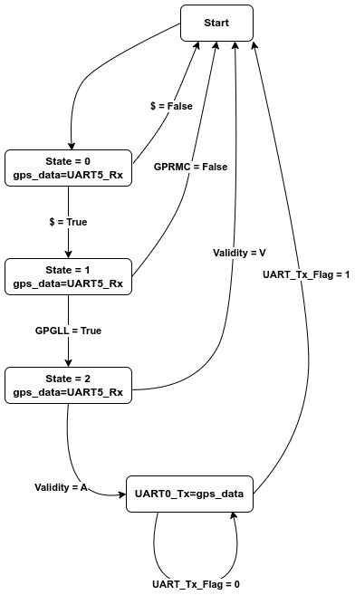
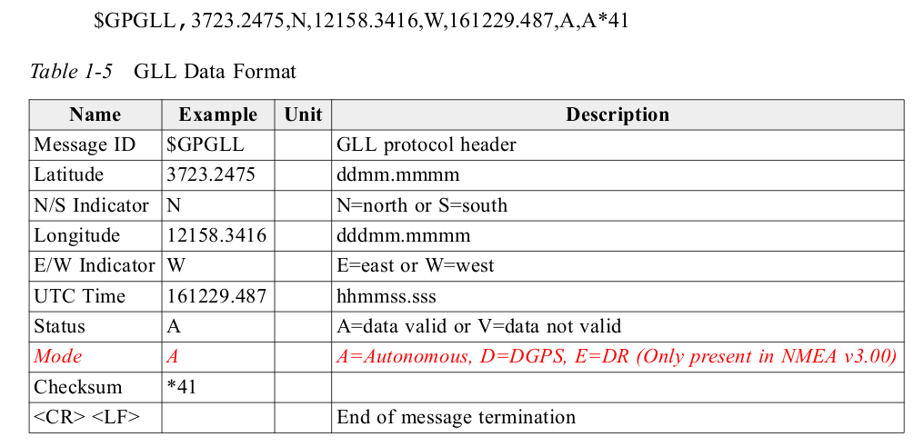
Stateflow Diagram: GPGLL

Slide 4
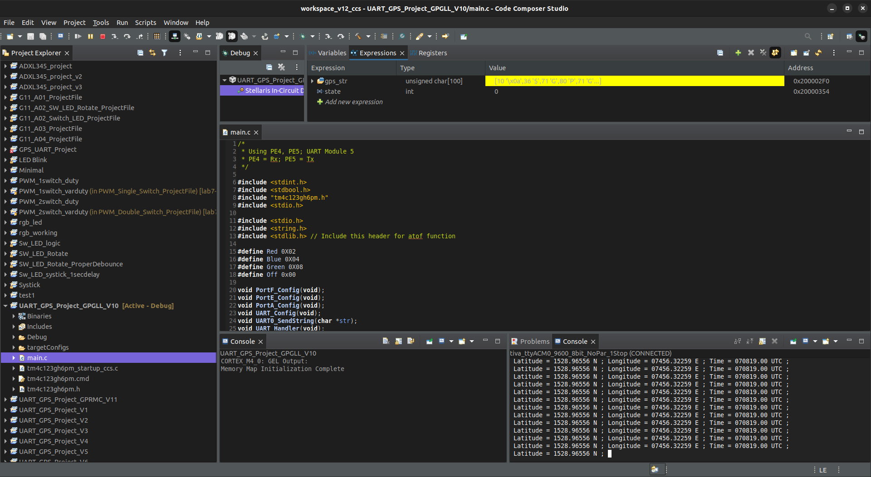
Output: GPGLL

Slide 5

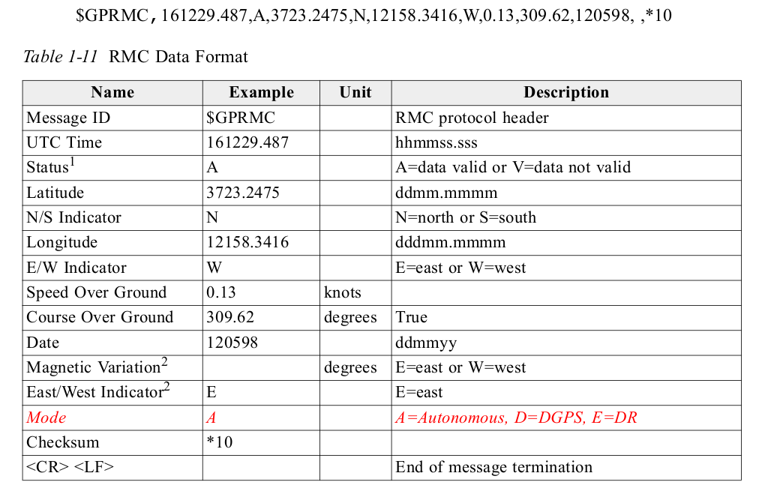
Stateflow Diagram: GPRMC

Slide 6
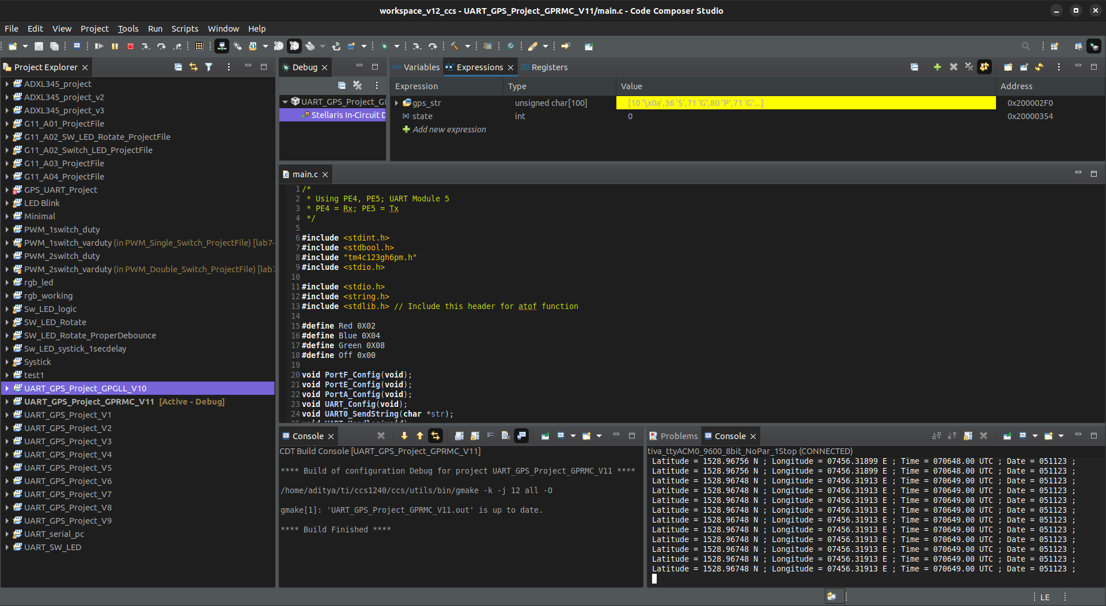
Output: GPRMC

Slide 7
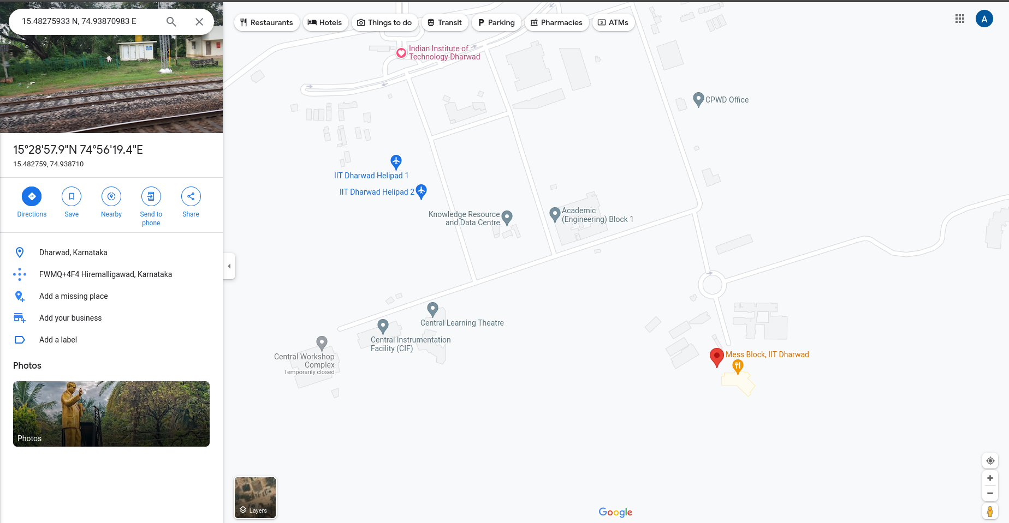
Output: Verification
Output: Verification
The coordinates received from the GPS module in GPGLL as well as GPRMC format are "15.48275933 N; 74.93870983 E". The received latitude and longitude coordinates are fed into google maps; and the obtained data is verified.

Slide 8
Results and Conclusion
Data is collected from the NEO-6 GPS Module successfully using UART communication protocol.
The data is parsed and separated for individual use
For GPGLL format, received Longitude, Latitude and UTC time is then sent to PC through UART based serial communication.
For GPRMC format, received Longitude, Latitude, UTC time and Date is then sent to PC through UART based serial communication.

Slide 9
Thank You

